Slide 1
Recurrent Neural Networks
(RNN)
Li Bofang

Slide 2
Previous content
Machine Learning
  Find optimal function F where F(input)=output
Classification and Regression
  Linear/Logistic Regression
  Multiple Layers Perceptron
  Convolutional Neural networks

Slide 3
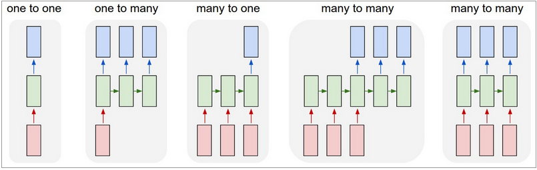
Previous content
Input/Output
  Number
  Vector
  Sequance of number
  Sequance of vector
http://karpathy.github.io/2015/05/21/rnn-effectiveness/

Slide 4
Outline
A simple problem (Part-of-speech tagging)
RNN
RNN variations
RNN applications
from https://class.coursera.org/ntumlone-003/lecture

Slide 5
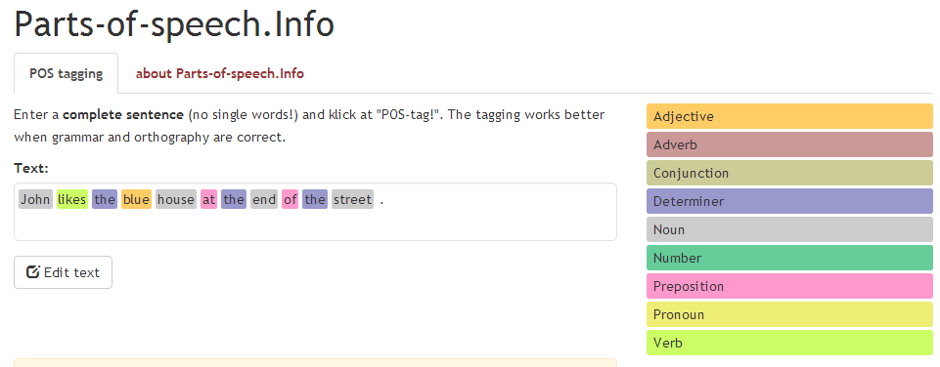
A simple problem
Part-of-speech tagging (POS tagging)
http://parts-of-speech.info/

Slide 6
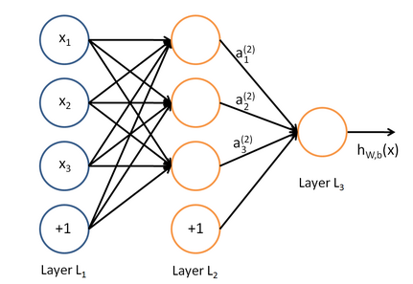
POS tagging
Input
  Sequence of words
Output
  Sequence of labels

Slide 7
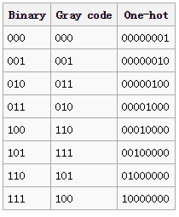
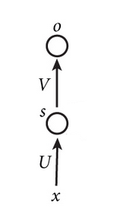
POS tagging
Input
  Word (one hot representation)
Output
  Label
Multi-layer perceptron(MLP)!

Slide 8
POS tagging
Why MLP may be unsuitable for this task
  How can(verb) you complain about higher taxes
  This soda can(noun) is made of aluminum

Slide 9
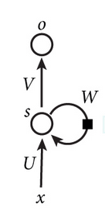
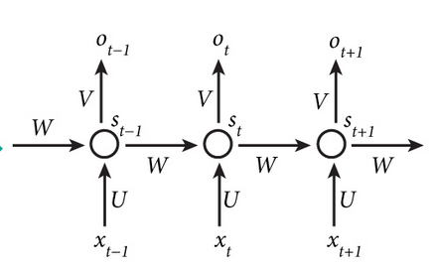
RNN
For MLP, hidden layer captures information about what happened in input.
For RNN, hidden layer captures information about what happened in all the previous time steps.

Slide 10

RNN

Slide 11
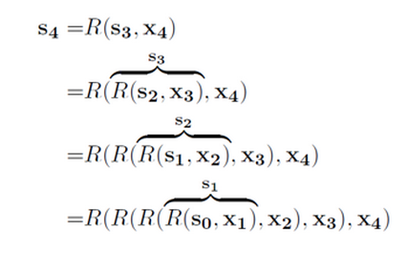
RNN
Unroll RNN
Weight/gradient exploding/vanishing problem

Slide 12
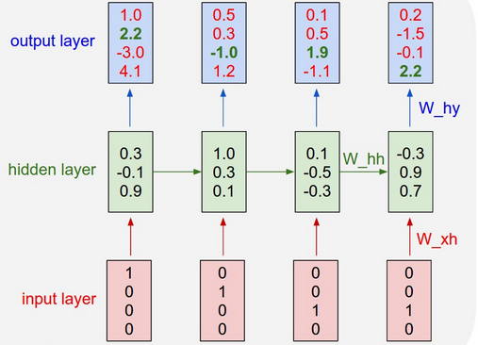
RNN visualization

Slide 13
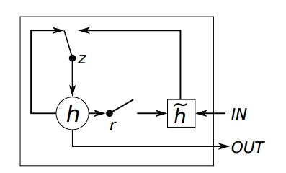
RNN variations
Bi-direction RNN
Long short-term memory/Gated RNN

Slide 14
RNN applications
One to many
  Image caption
Many to one
  Text classification

Slide 15
RNN applications
Many to many 1
  Machine translation
  Question answering
  Speech recognition
Many to many 2
  POS tagging

Slide 16
thanks

